Slide 4
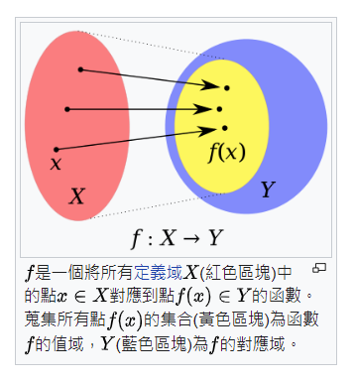
For %%i in ( ) DO command

Slide 7
syntax-FOR-Files
FOR %%parameter IN (set) DO command
syntax-FOR-Files-Rooted at Path
FOR /R [[drive:]path] %%parameter IN (set) DO command
syntax-FOR-Folders
FOR /D %%parameter IN (folder_set) DO command
syntax-FOR-List of numbers
FOR /L %%parameter IN (start,step,end) DO command
syntax-FOR-File contents
FOR /F ["options"] %%parameter IN (filenameset) DO command
FOR /F ["options"] %%parameter IN ("Text string to process") DO command
syntax-FOR-Command Results
FOR /F ["options"] %%parameter IN ('command to process') DO command

Slide 10
Q&A
FOR %%var IN (set) DO 有幾種選擇(options)? 分別代表甚麼功能 或 作用?

Slide 11
FOR %%variable IN ( ) DO 有幾種選擇? 分別代表甚麼功能 或作用?

